Slide 1
Initial Setup Raspberry Pi
David Crook
@Data4Bots
Questions: dacrook@Microsoft.com

Slide 2
Agenda
The ‘me’ slide
Things to know
Goals
Content
Summary
Continuous Q&A

Slide 3

David Crook
Microsoft Developer Evangelist
Focused on Machine Learning and Embedded Systems
Enjoys challenges
Likes Fishing + Brazilian Jiu Jitsu
Typically not together
dacrook@Microsoft.com
(980)228-6278
@Data4Bots
www.indiedevspot.com

Slide 4
Stuff you should Know About
Additional Resources
Channel9: http://channel9.msdn.com
Hackster: https://www.hackster.io
Stack Overflow: http://electronics.stackexchange.com/
BizSpark
Free Azure
Free Tools Network Partner Give to your startups for free
Microsoft Innovation Center
Hack Tuesdays: Mentoring every Tuesday 11am – 4pm
Free Co-Working for Startups: dacrook@Microsoft.com to apply
Free Training: See schedule here: http://indiedevspot.com/events/

Slide 5
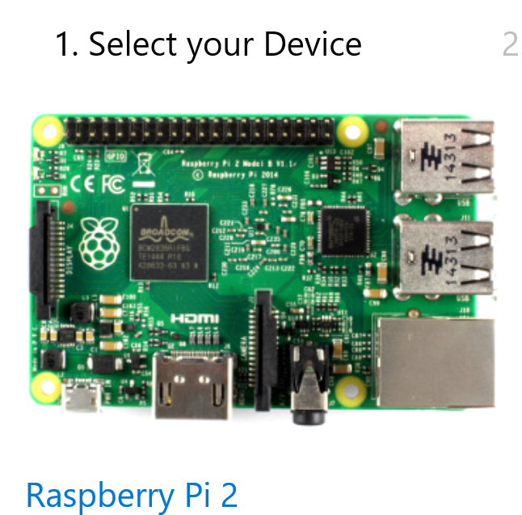
Future Reference Getting Started
http://ms-iot.github.io/content/en-US/GetStarted.htm

Slide 6
Goals of Presentation
Understanding the Pi
Installing Windows 10 IoT Core
Power Considerations
Wi-Fi Options
PowerShell Setup

Slide 7
What is the Raspberry Pi?
Compared to Arduino

Slide 8
What is Windows 10 IoT Core
Why not Raspbian

Slide 9
Why do I care about them?
Power
IoT
Development Tools
Languages
Libraries
Visual Studio
Dev Ops Tool Chain
Visual Studio
Build

Slide 10
Wi-Fi Options
Official Raspberry Pi Dongle
Simple setup
Possible issues if multiple on same network (all are default named minwinpc)
Ethernet Adapter (included in PG Kits)
More difficult setup
More robust setup

Slide 11
PowerShell Setup
Headless
No UI, No Keyboard
Ethernet Adapter
Comes with PG Kit
Official dongles are nearly impossible to get.
Remember Power Considerations
USB power packs might supply 5V, but not enough Amps

Slide 12
Connect Everything
Supply Pi with Power
Connect Ethernet Cable to Adapter to USB into laptop

Slide 13
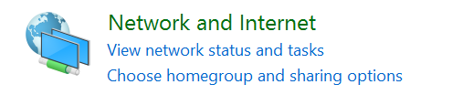
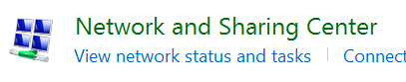
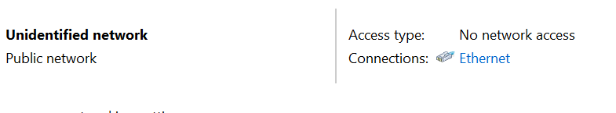
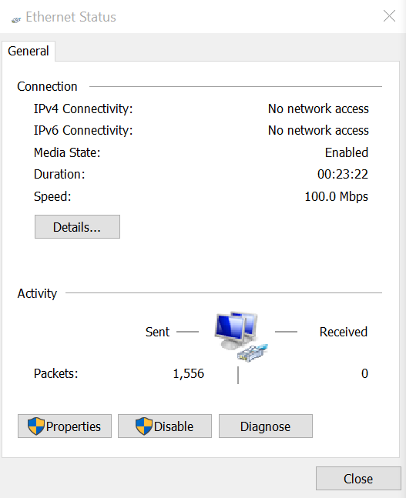
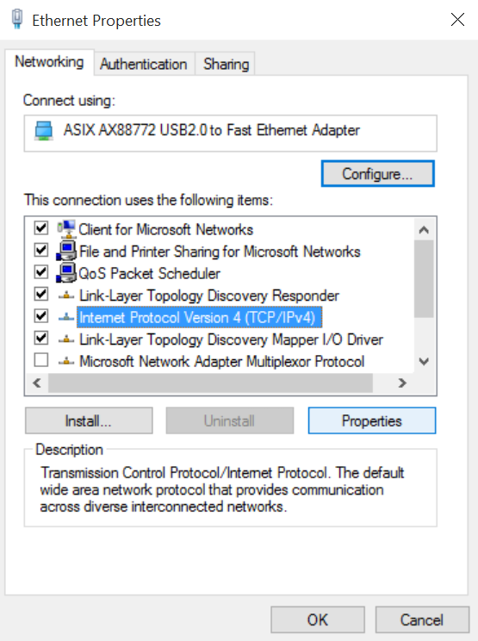
Enabling Wi-Fi Bridging
Open Control Panel
Navigate to Network and Internet
Navigate to Network & Sharing
Click Ethernet
Go to Properties
Select IPV4
Select Properties

Slide 14
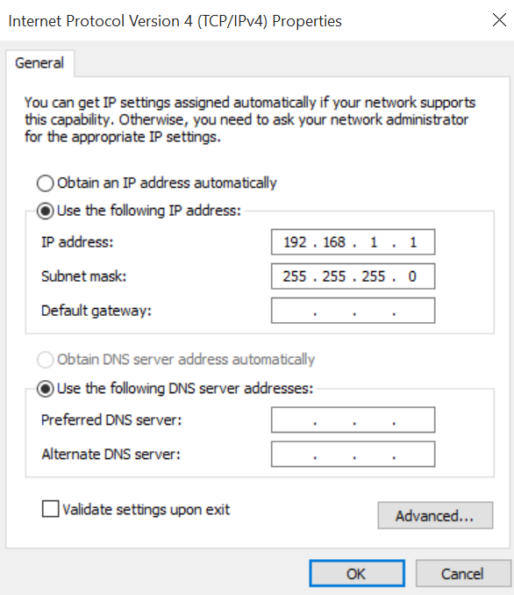
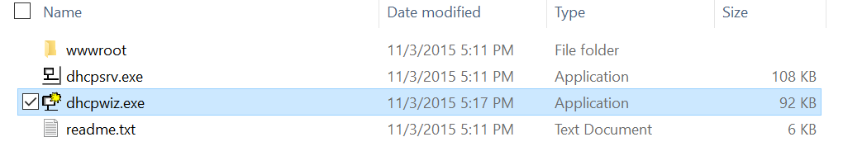
Enabling Wi-Fi Bridging Cont.
Set your Ip Address to 192.168.1.1
Set your Subnet mask to 255.255.255.0
Close and Save settings
Download: http://www.dhcpserver.de/
Extract and run wizard

Slide 15
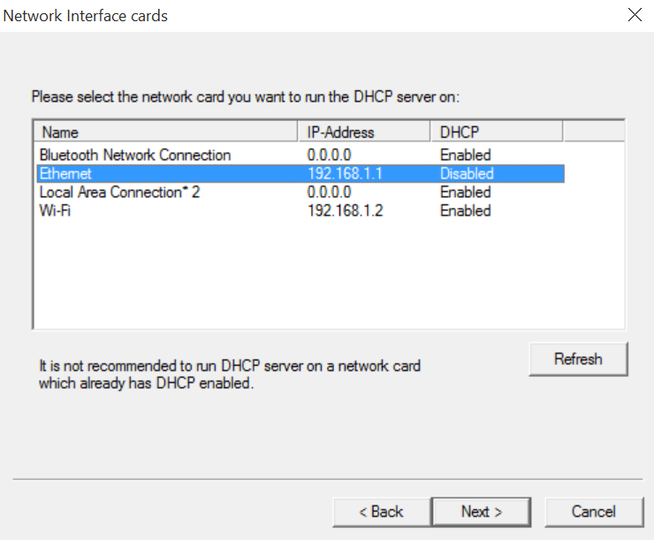
Enabling Wi-Fi Bridging Cont. Cont.
Select Ethernet (notice DHCP is disabled)
Do not select other protocols
Accept default configurations
Click “write ini file”
Click Finish
Click “Continue as tray app”
Click allow access on firewall setup

Slide 16
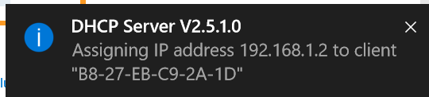
Enabling Wi-Fi Bridging Cont. Cont. Cont.
Boot up the pi.
Notice a popup for a new ip address.

Slide 17
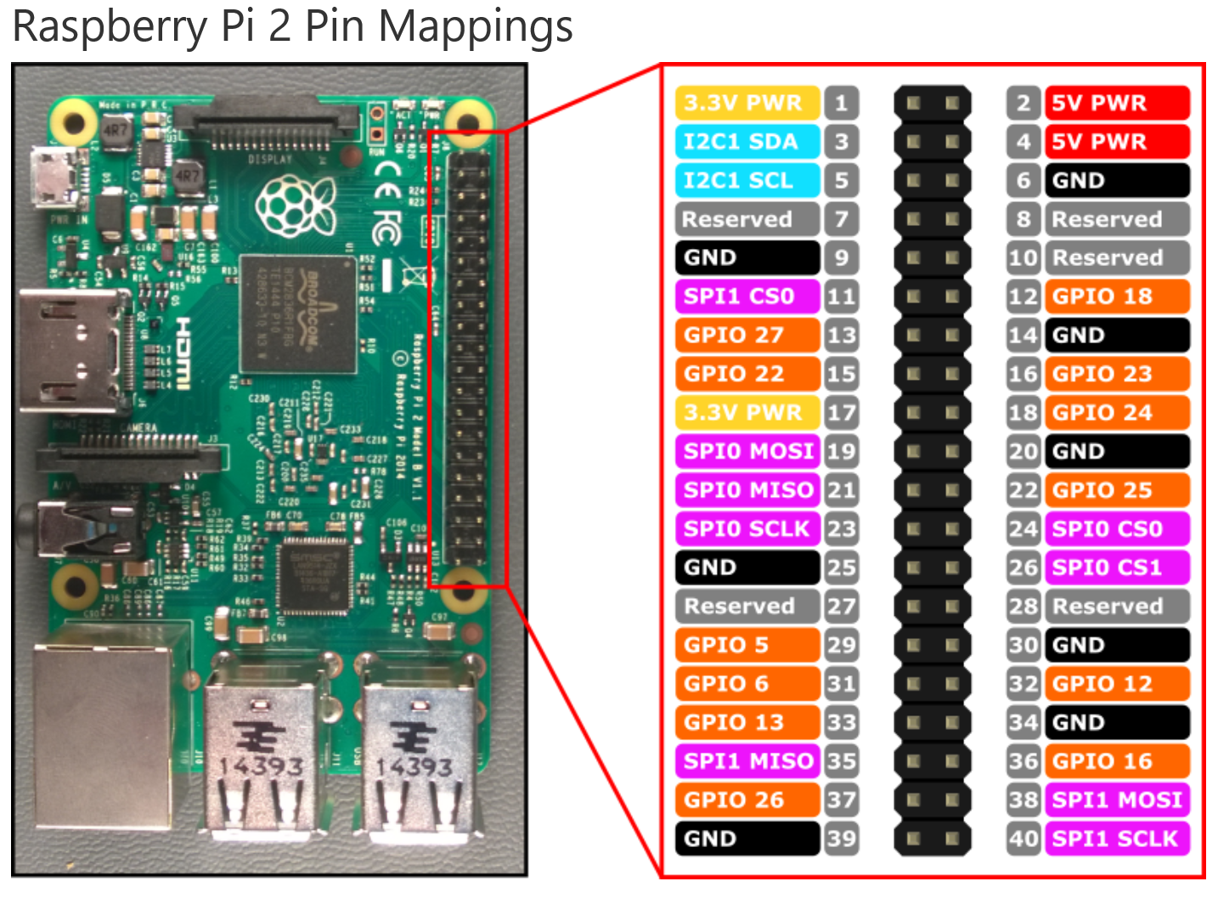
Will not concern
ourselves with:
I2C
SPI
Focus just on
Power
Ground
Gpio
Physical Pin
vs
Logical Pin

Slide 18
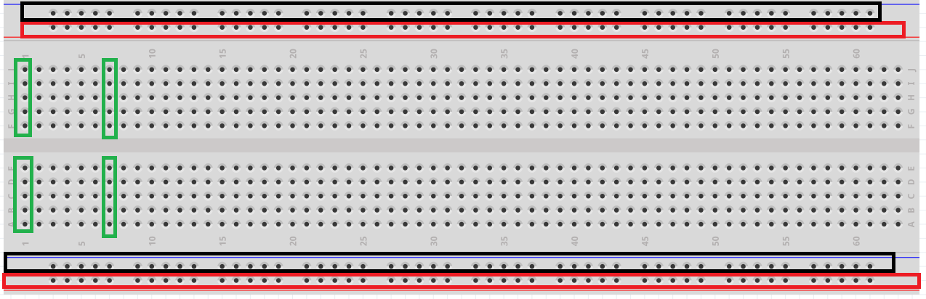
How a Breadboard works

Slide 19
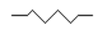
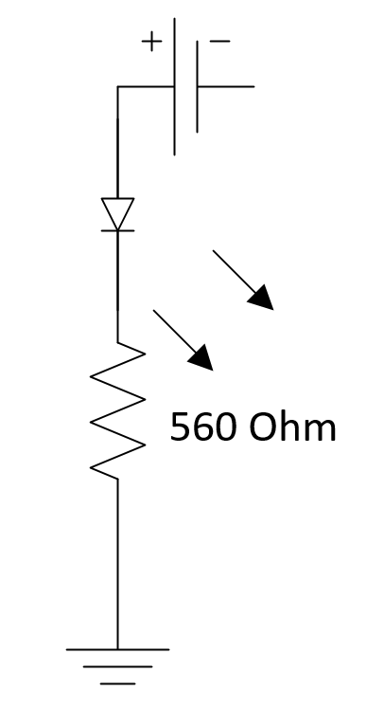

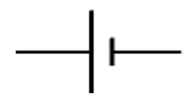
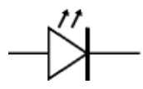
Circuit Schematics – Symbols – LED Sample
Resistor
Ground
Power
LED

Slide 20
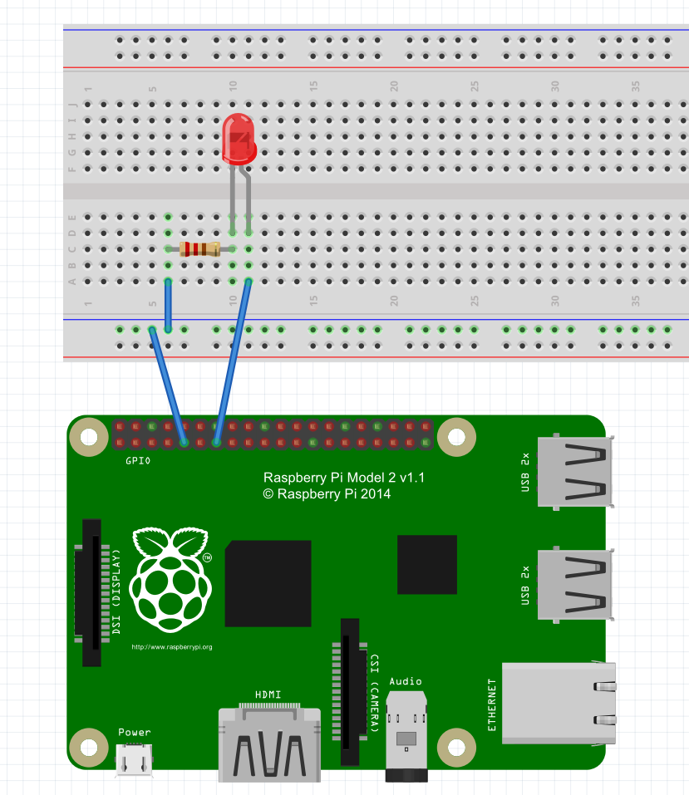
Wiring Diagram

Slide 21
Blinking the light
Open Visual Studio 2015 Community
Excellent programming tool.
Create new Project and Solution
File -> New -> Project

Slide 22
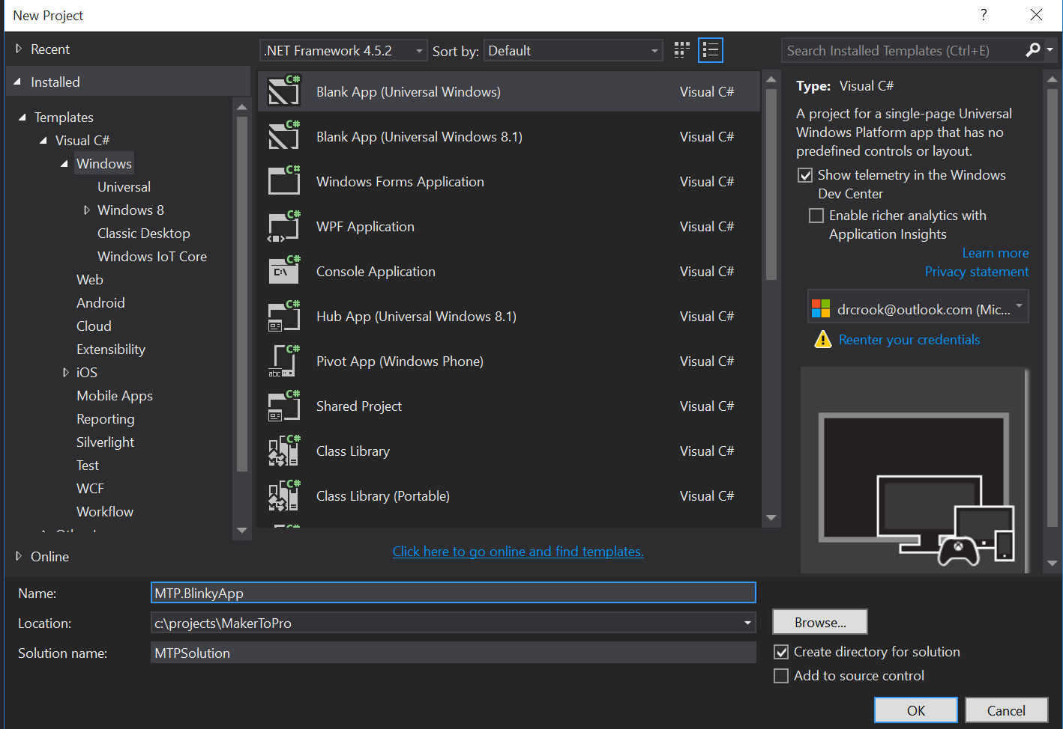

Slide 23
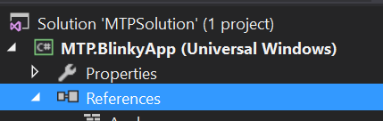
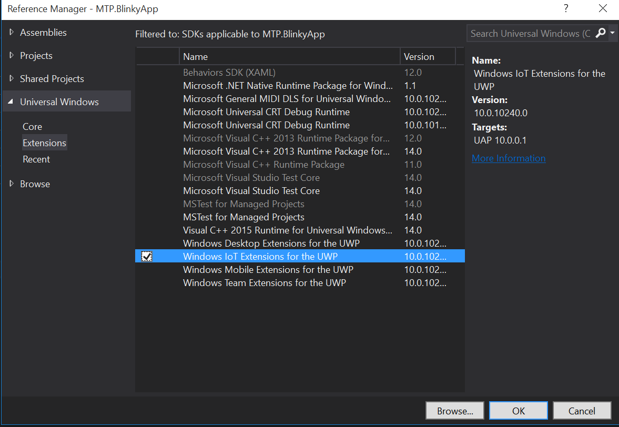
Getting Set Up
Add a Reference
Right Click -> Add Reference
Windows IoT Extensions for the UWP
Under Universal Windows
In Extensions
Select
Click Ok

Slide 24
Have these using statements
In the file App.Xaml.cs
using System;
using Windows.ApplicationModel;
using Windows.ApplicationModel.Activation;
using Windows.Devices.Gpio;
using Windows.UI.Xaml;
using Windows.UI.Xaml.Controls;
using Windows.UI.Xaml.Navigation;
Have these class level private variables
private const int ledPinNumber = 27;
private GpioPin ledPin;
private GpioPinValue ledVal;
private DispatcherTimer timer;

Slide 25
Modify the Constructor
public App()
{
Microsoft.ApplicationInsights.WindowsAppInitializer.InitializeAsync(
Microsoft.ApplicationInsights.WindowsCollectors.Metadata |
Microsoft.ApplicationInsights.WindowsCollectors.Session);
this.InitializeComponent();
this.Suspending += OnSuspending;
//Add these lines
InitGPIO();
InitBlinky();
}

Slide 26
Initialize GPIO
private void InitGPIO()
{
var gpio = GpioController.GetDefault();
if (gpio == null)
{
throw new Exception("Gpio expected on this device");
}
ledPin = gpio.OpenPin(ledPinNumber);
ledPin.SetDriveMode(GpioPinDriveMode.Output);
ledPin.Write(GpioPinValue.Low);
ledVal = GpioPinValue.Low;
}

Slide 27
Initialize Blinking
private void InitBlinky()
{
timer = new DispatcherTimer();
timer.Interval = TimeSpan.FromMilliseconds(500);
timer.Tick += Timer_Tick;
timer.Start();
}

Slide 28
Add Handler for Timer Tick
private void Timer_Tick(object sender, object e)
{
if(ledVal == GpioPinValue.High)
{
ledPin.Write(GpioPinValue.Low);
ledVal = GpioPinValue.Low;
}
else
{
ledPin.Write(GpioPinValue.High);
ledVal = GpioPinValue.High;
}
}

Slide 29
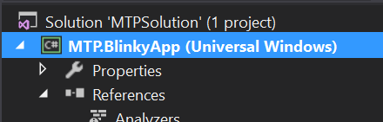
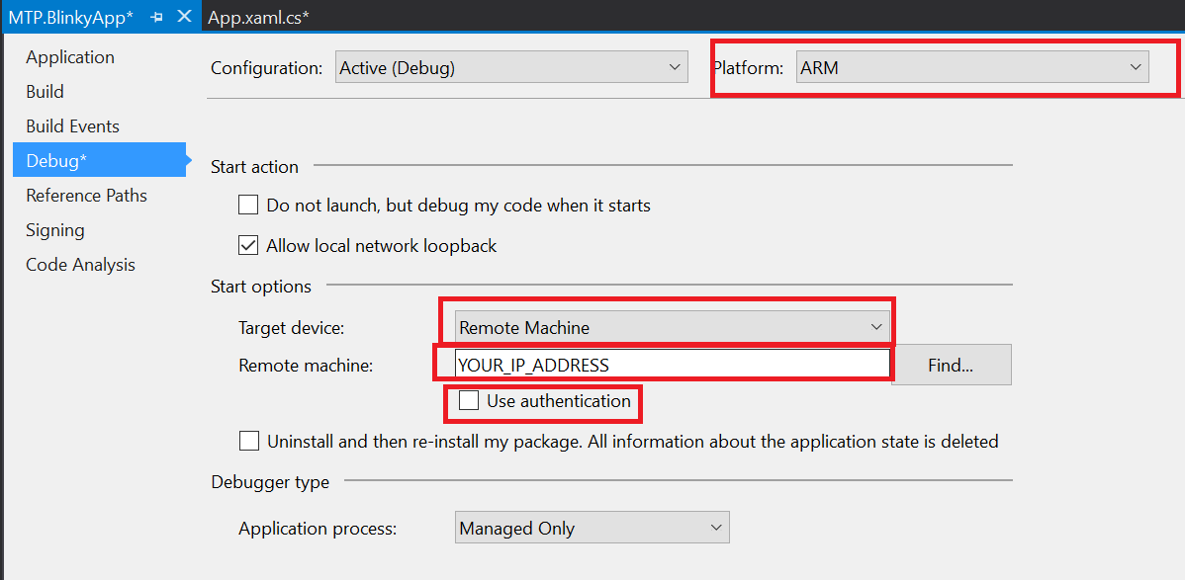
Set Build for your Device
Right Click Project
Properties (at the bottom)
ARM
Remote
Your IP
No Auth

Slide 30
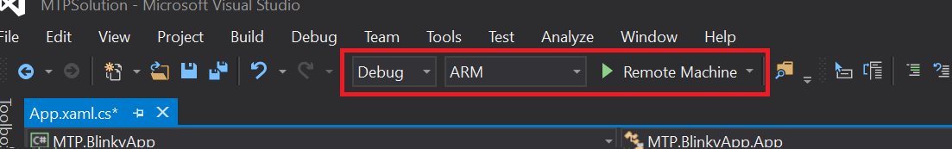
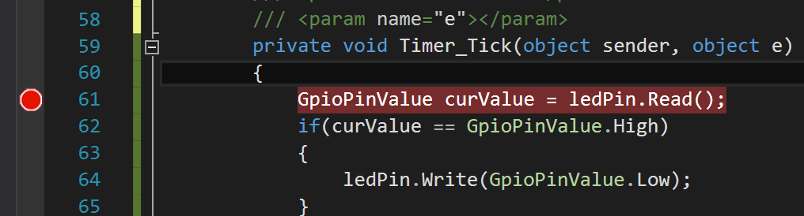
Deploy && Debug
Set to ARM
Click In Gray Area
Creates red breakpoint
Click Green Arrow
You can remove breakpoint and click green arrow to continue.

Slide 31
Take a breather

Slide 32
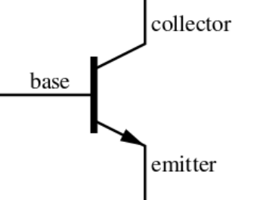
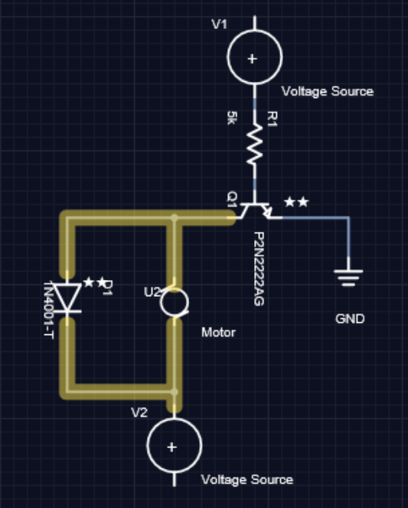
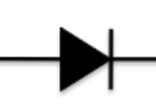
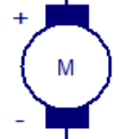
Circuit Schematics – Symbols – MOTORS!
Transistor
Diode
Motor

Slide 33
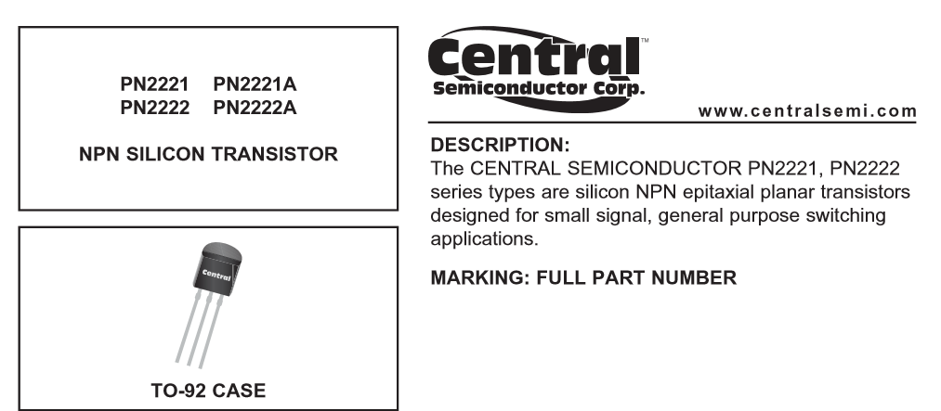
The Data Sheet – Part 1
We have: PN2222A

Slide 34
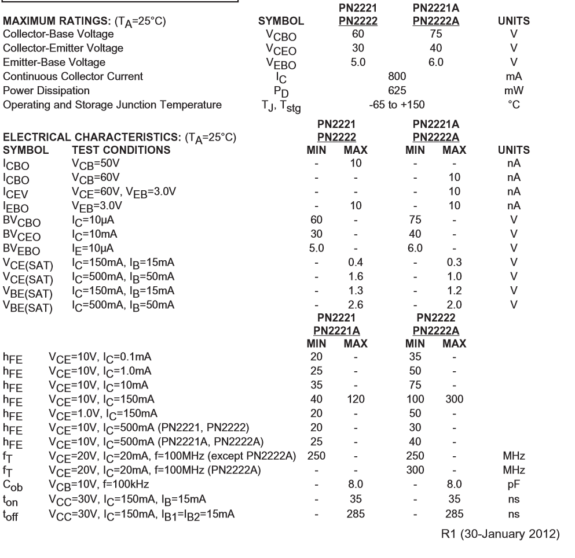
The Data Sheet – Part 2
Important here is
Maximum ratings

Slide 35

The Data Sheet – Part 3

Slide 36
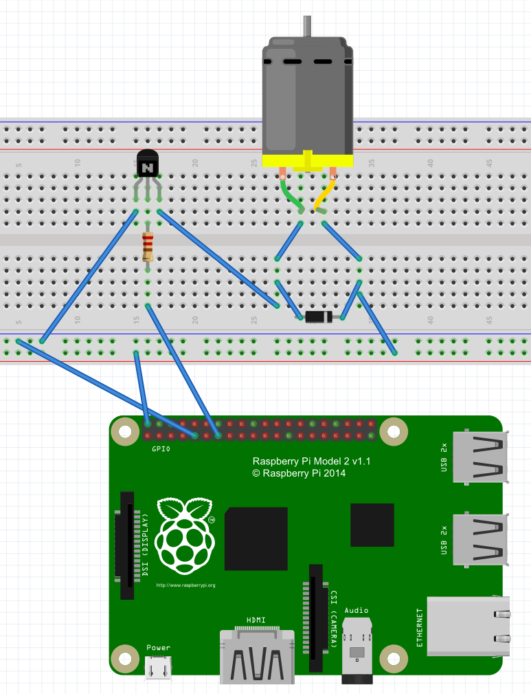
Wiring Diagram

Slide 37
The Code…
Remains EXACTLY the same ☺
We are switching the motor on/off every 500 milliseconds, just like we did with the LED.

Slide 38
What Next?

Slide 39
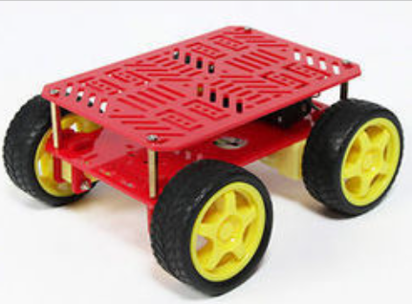
Create a car!
Control 4 motors
Create functions for:
Left
Right
Forward
Back

Slide 40

Control a Sprinkler System!

Slide 41
There is more!

Slide 42

Brown Bag Series
Electronics 101
3 Rotating Sessions
IoT 101
3 Rotating Sessions
Machine Learning 101
2 Rotating Sessions
3D Printing 101
Just 1 session!

Slide 43
Questions?

Slide 44
dacrook@Microsoft.com
(980)228-6278
@Data4Bots
www.indiedevspot.com

